Slide 1


Load Factor Analysis
Electric Power Load Analysis (EPLA)
Revision of 25 May 2026
Dr. Norbert Doerry
http://doerry.org/norbert/MarineElectricalPowerSystems/index.htm
© 2026 by Norbert Doerry
This work is licensed via: CC BY 4.0 (https://creativecommons.org/)

Slide 2
Essential Questions
What is Load Factor Analysis? | Remember
How is a load factor determined? | Apply
How should load factors be assigned for cycling loads? | Understand
How should load factors from a parent design be adjusted? | Understand
How should load factors be determined from measured data? | Understand

Slide 3
Load Factor Analysis
Bottoms up estimate of the electrical load for different operating conditions and different ambient conditions.
Multiple purposes
  24-hour average load for fuel consumption calculations
  Determine if electrical system equipment has adequate power rating
    Cycling loads may result in temporary increases in total operating load over the long-term average.
    The duration and magnitude of the increase in total operating load may require the equipment to have a higher power rating than an estimate based on 24-hour averages.
    Power electronic sources typically have less capability to supply an overload magnitude and duration as comparted to a synchronous generator.

Slide 4
Load Factor Analysis - process
Load List
  Identifies all loads onboard ship
  Identifies the connected load of each load
  Identifies the load’s connections to the power system
Load factors assigned to each load
  Possibly different load factors for each combination of operating condition and ambient condition
  Load factors for 24-hour averages and equipment power rating may differ
    Equipment power rating may need to account for cycling loads
Total Operating Load
  Sum the products of the load factor and connected load for all the loads
  Calculated separately for each combination of operating condition and ambient condition
Ship Demand Power
  Apply margin and service life allowance to the total operating load

Slide 5
Cycling Loads
Cycling loads are on for a period of time, and off for a period of time
  On periods and off periods may vary
  The load when on may vary
For 24-hour average computations
  Load factor is the average power over the connected load
For equipment sizing
  24-hour average-based load factor is likely too low
  Peak value-based load factor is likely too high
  The appropriate load factor depends on the magnitude and type of other loads online

Slide 6
Calculating Load Factors
Load analysis
Scaling from parent design
Using default values
Measured data
Modeling and simulation

Slide 7
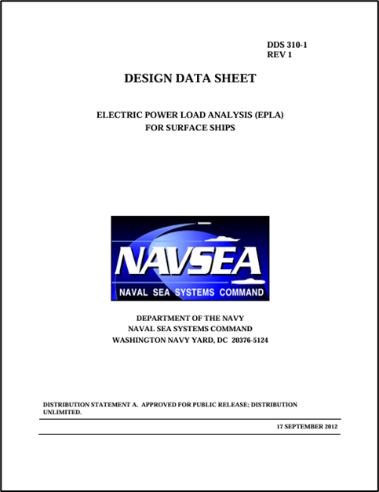
Load analysis
Assign load factors based on an investigation of the load behavior
From DPC 310-1
  Zero load factors assigned to seldom used equipment
  Motor operating at full load for an extended period of time
    Use 0.9 for ship electrical equipment rating,
    Use the long-term average load for 24-hour average calculations.
  All standby units are assigned zero load factors except when the standby unit is actually kept running or is based on percent of power used while idling.
  Mutually exclusive loads
    Assign 0 for the load with the lower operating load for determining ship electrical equipment rating
    Assign each load with their average load divided by their connected load for 24-hour average calculations
  In some cases, calculating and tabulating actual kW instead of using load factors is warranted
    Power conversion equipment
    Losses associated with power distribution equipment efficiencies
  Consider using zonal load factor method for cycling loads

Slide 8
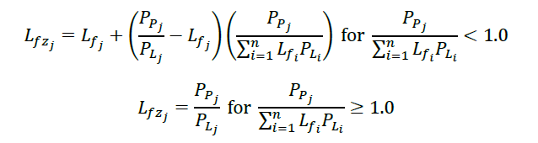
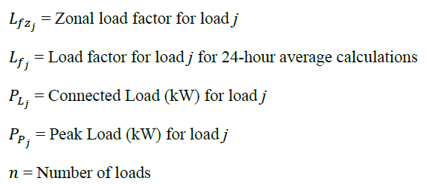
Using Zonal Load Factor process for estimating load factor for cycling load
Used for converting load factor calculated for 24-hour averages to load factor for determining equipment rating.
Based on relative magnitudes of other loads powered by the electrical system equipment

Slide 9
Scaling from parent design
Using a parent design for developing the load list is a normal practice
  Load list is modified to reflect differences from the parent design
Load factors from a parent design should not be blindly used
  Should review each load factor and adjust based on differences in
    Equipment
    Concepts of Operation

Slide 10

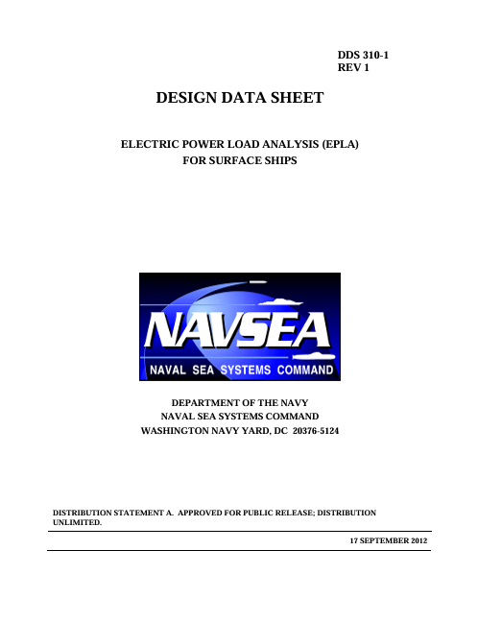
Using default values
Default values are available from
  DPC 310-1
  IEEE Std 45.1
Should only be used if cannot obtain better data elsewhere

Slide 11
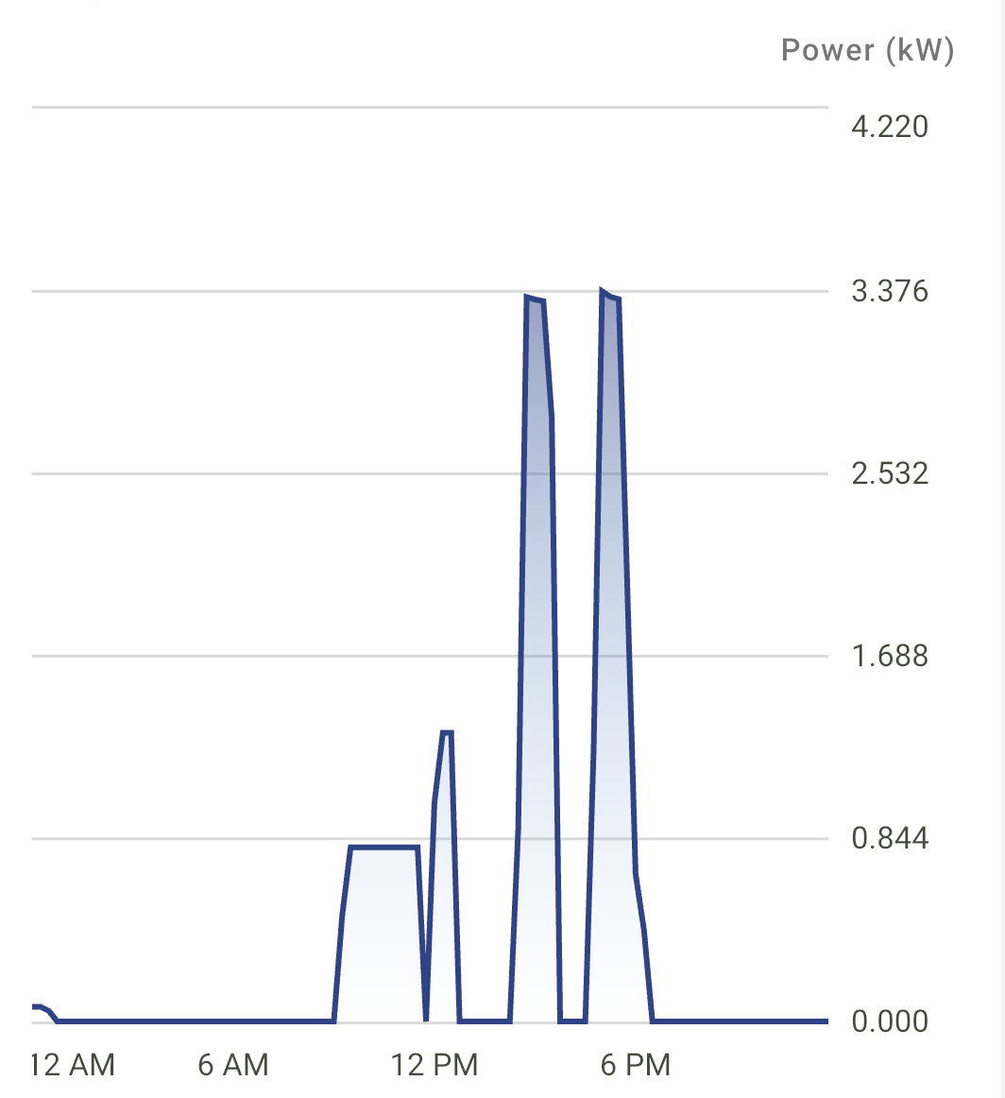
Measured Data
Measure electrical load of a particular load for an extended period of time on an existing ship
Use the average value of the power for the 24-hour average load factor
Load factor for cycling loads
  Measure the total load for the corresponding group of loads
  Identify the peak value in the measured data that the power system equipment should handle
  Apportion difference between peak value and average value to the various cycling loads
Alternate method for load factor for cycling loads
  Use the zonal load factor method to adjust the 24-hour average load factor for a given set of loads supplied by the power system equipment

Slide 12
Modeling and Simulation
Perform a time-based simulation of the power system to develop a substitute for measured data
  Employ same calculation methods as for the measured data
Quasi-steady-state analysis is likely sufficient

